Slide 1

Project 1- GAME AI
Submitted By:
Megha Jayakumar
Shramana Thakur
Rishi Tripathi
Srinivas Nandagudi Sridharamurthy
Subbulakshmi Sundaram
Deepansh Pandey

Slide 2
Task 1.2 Tic-Tac-Toe
Collecting game statistics:
Ran the tic-tac-toe game for 10000 matches
For each winning game (by either player) we stored following details into a Python dataframe:
Winning player
Final game board
Winning 3-in-a-line configuration
X | O | O
 | X
 |  | X
1
 | 1
 |  | 1
O | O | O
X | X
 |  | X
1 | 1 | 1

Slide 3
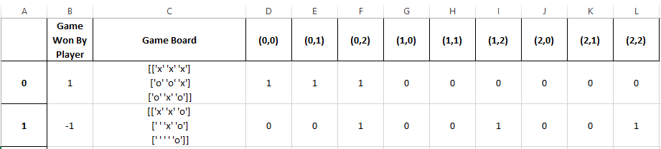
Task 1.2 Tic-Tac-Toe
Collecting game statistics (contd.):
Game Stats.xlsx

Slide 4
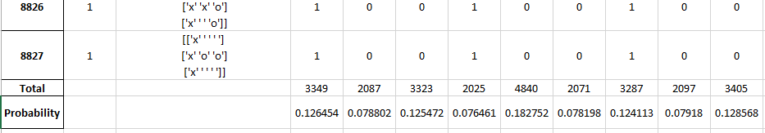
Task 1.2 Tic-Tac-Toe
Collecting game statistics (contd.):
Calculated the total frequency count of occurrence of each cell in every game that resulted in a win (for either player)
Calculated the ‘auspiciousness’ of each cell by dividing the count by the total number of games that resulted in a win * 3
Game Stats.xlsx

Slide 5
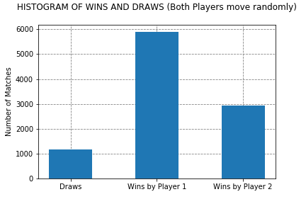
Task 1.2 Tic-Tac-Toe
Collecting game statistics (contd.):

Slide 6
Task 1.2 Tic-Tac-Toe
Probabilistic Strategy:
Using probabilities calculated in the previous task, we obtain the following matrix of values depicting the “goodness” of each cell in contributing to a win:
0.126454 | 0.078802 | 0.125472
0.076461 | 0.182752 | 0.078198
0.124113 | 0.07918 | 0.128568

Slide 7
Task 1.2 Tic-Tac-Toe
Probabilistic Strategy (contd.):
Made Player X place “X”s in free cells on board having the max. value as per the probability matrix, and Player O moved randomly.
0.126454 | 0.078802 | 0.125472
0.076461 | 0.182752 | 0.078198
0.124113 | 0.07918 | 0.128568
 | X
 |  | O
 | X

Slide 8
Task 1.2 Tic-Tac-Toe
Probabilistic Strategy (contd.):
Made Player X place “X”s in free cells on board having the max. value as per the probability matrix, and Player O moved randomly.
0.126454 | 0.078802 | 0.125472
0.076461 | 0.182752 | 0.078198
0.124113 | 0.07918 | 0.128568
 |  | O
 | X
 |  | X

Slide 9
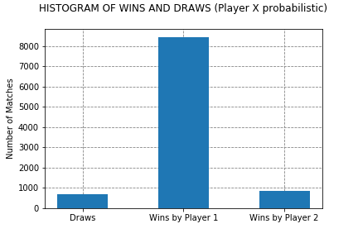
Task 1.2 Tic-Tac-Toe
Probabilistic Strategy (contd.):

Slide 10
Task 1.2 Tic-Tac-Toe
Heuristic Strategy:
For each of Player X’s moves, each free cell was evaluated using the following heuristic function:
3 cells in a line empty : +1
One of player’s symbol in a line : +10
One of opponent’s symbol in a line: -10
Both player’s and opponent’s symbol in a line: 0
Two of player’s symbols in a line: +150
Two of opponent’s symbols in a line: +100

Slide 11
Task 1.2 Tic-Tac-Toe
Heuristic Strategy (contd.):
+ 1 (row) +1 (col) +1 (L-R diag) = +3 | + 1 (row) +1 (col) = +2 | + 1 (row) +1 (col) +1 (R-L diag) = +3
+ 1 (row) +1 (col) = +2 | + 1 (row) +1 (col) +1 (L-R diag) +1 (R-L diag) = +4 | + 1 (row) +1 (col) = +2
+ 1 (row) +1 (col) +1 (R-L diag) = +3 | + 1 (row) +1 (col) = +2 | + 1 (row) +1 (col) +1 (L-R diag) = +3
 | X

Slide 12
Task 1.2 Tic-Tac-Toe
Heuristic Strategy (contd.):
- 10 (row) +1 (col) +10 (L-R diag) = +1 |  | - 10 (row) +1 (col) +10 (R-L diag) = +1
+ 10 (row) +1 (col) = +11 |  | + 10 (row) +1 (col) = +11
+ 1 (row) +1 (col) +10 (R-L diag) = +12 | + 1 (row) +0 (col) = +1 | + 1 (row) +1 (col) +10 (L-R diag) = +12
 | O
 | X
 | O
 | X
X

Slide 13
Task 1.2 Tic-Tac-Toe
Heuristic Strategy (contd.):
 |  | + 100 (row) +1 (col) +10 (R-L diag) = +111
+ 150 (row) -10 (col) = +140
+ 1 (row) - 10 (col) +10 (R-L diag) = +1 | + 1 (row) +0 (col) = +1 | + 1 (row) +10 (col) +0 (L-R diag) = +11
O | O
 | X | X
O | O
X | X | X
Special Case: Choosing win over stopping opponent’s loss

Slide 14
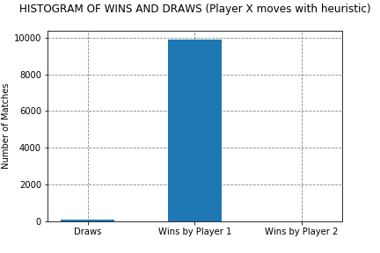
Task 1.2 Tic-Tac-Toe
Heuristic Strategy (contd.):

Slide 15
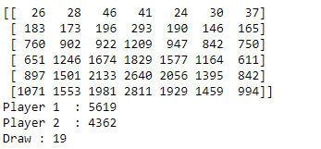
Task 1.3 Connect 4
Taking inspiration from the Tic-Tac-Toe code, Modifications were done in board Configuration, Winning Condition, Coin placement strategy.
The code was run for 10,000 times and the statistics were taken by placing +1 for every cell when it contributed for the player’s win.
The Algorithm and strategies considered for Computing Statistics are explained in the next slides.

Slide 16
Task 1.3 Connect 4
Algorithm used for the game and Calculating the Statistics:
Initialize the Game matrix for the board size of 6x7.
Initialize player number, move counter and set noWinnerYet to True.
While move_still_possible(gameState) and noWinnerYet:
Invoke the method move_at_random by passing the gameState matrix and the current player number.
The random move is marked in the gameState.
Print the gameState to see the move of the player
Invoke the method find_winner (Returns True if sequence is formed and False when there is no sequence found) by passing the gameState and player
Horizontal Check : Loop through the rows in the gameState. Invoke the method is_sequence_formed by passing the gameState, row and sequence which returns ‘True’ if there’s a sequence of 4 or ‘False’ if there is no sequence found.
When the is_sequence_formed returns true:
Invoke modify_gameStats.
Find the index of the sequence formed by using the position and the substring.
i=findSubstring(S[position],substring
Counter the position in gameStats. (Game Statistics)
gameStats[position,i:i+len(substring)]+=1

Slide 17
Task 1.3 Connect 4
Vertical Check : Loop through the columns in the gameState. Invoke the method is_sequence_formed by passing the gameState, column and sequence which returns ‘True’ if there’s a sequence of 4 or ‘False’ if there is no sequence found.
When the is_sequence_formed returns true:
Invoke modify_gameStats.
Find the index of the sequence formed by using the position and the substring
i=findSubstring(S[:,position],substring)
Counter the position in gameStats. (Game Statistics)
gameStats[i:i+len(substring),position]+=1
Diagonal Check (Left_to_Right diagonal and Right_to_Left diagonal):
Looping offset in the range GameState S.shape[1]*-1 to S.shape[1]:
Get the diagonals :
left_to_right = S.diagonal(offset, 1, 0).tolist()
right_to_left = S[::-1].diagonal(offset, 1, 0).tolist()
If both the sequences are less than 4 , Continue

Slide 18
Task 1.3 Connect 4
Invoke the method is_sequence_formed and if it returns true:
Invoke modify_gameStats.
Find the index of the sequence formed by using the position and the substring and counter the position in the matrix.
If left_to_right:
i = findSubstring(S.diagonal(position,1,0),substring)
Counter:
starts = [0,0+((-1)*position)] if position<0 else [0+position,0]
starts = [starts[0]+i,starts[1]+i]
for X in range(0,4):
gameStats[starts[0]+X, starts[1]+X]+=1
if right_to_left:
i = findSubstring(S[::-1].diagonal(position, 1, 0),substring)
Counter:
starts = [S.shape[0]-1,0+((-1)*position)] if position<0 else [S.shape[0]-1-position,0]
starts = [starts[0]-i,starts[1]+i]
for X in range(0,4):
gameStats[starts[0]-X, starts[1]+X]+=1

Slide 19
Task 1.3 Connect 4
If find_winner returned true set the flag noWinnerYet as false, display the winner and increment the player1wins or player2wins counter by 1 according to the win.
If noWinnerYet is True, display the message game ended in draw and increment the gameDraw counter by 1.
Print the gameStats (Game statistics), player1wins, player2wins and gameDraw to get a complete picture of the statistics of 2 players playing in random.

Slide 20
Task 1.3.2 Connect 4 GUI
Logic using pygame:
print_board():
1.the board is flipped since because of the orientation of the board and the starting of the board being at the top and print the board
draw_connect4_board():
1.draw a rectangle using pygame function with the length to be row count which is 6 multiplied by the block size which is taken to be 100 pixels plus an additional row for display and column width to be number of columns multiplied by block size.
2.draw circles where the coin is to be dropped for which the radius would be about half the size of block.
check_winner(board,player):
1.checks horizontally if there are 4 coins of the same colour depending on the player passed ,if yes returns true
2.checks vertically if there are 4 coins of the same colour depending on the player passed ,if yes returns true
3.checks positively sloped diagonal if there are 4 coins of the same colour depending on the player passed ,if yes returns true
4.checks negatively sloped diagonal if there are 4 coins of the same colour depending on the player passed ,if yes returns true

Slide 21
Task 1.3 Connect 4 GUI
while no player has won yet:
1.check for an event if the user wants to quit from the game
2.check if there is any pygame mouse motion
Depending on player 1 or 2,the corresponding colour of coin keeps moving on the top slab depending on the user motion
3. If a mouse down event which is a pygame function is triggered:
a1. If player one then blue coin is dropped in the column user clicked onto in the next empty position
a2. Check_winner(board,1) which is basically passing the connect 4 board witth player 1
a3. If a2 step returns true a display is put saying player 1 has won
b. If player two then yellow coin is dropped in the column user clicked onto in the next empty position
b2. Check_winner(board,2) which is basically passing the connect 4 board witth player 2
b3.if b2 step returns true a display is put saying player 2 has won
4. A counter turn is incremented by 1 and then mod by 2 so that the turns are alternated after every turn
5. A variable Counter is incremented after every coin drop
6. if the Counter is greater than equal to 42 and if no player has won yet:
A display is put up that the game is a draw.

Slide 22
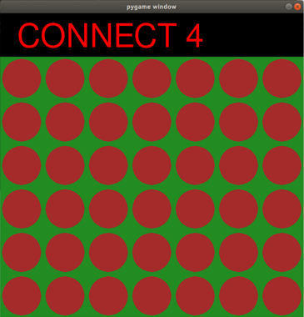
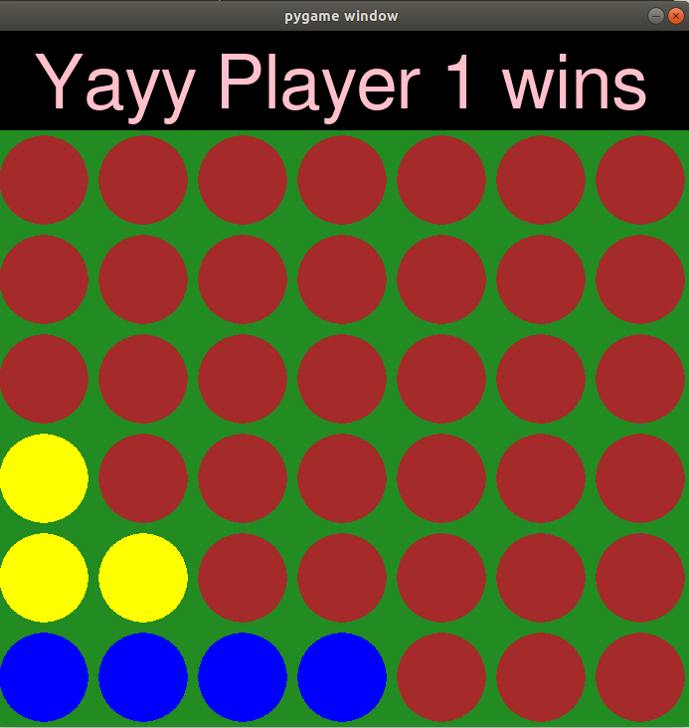
Task 1.3 Connect 4 GUI
Screen Shots:
Game Board: Player One wining :

Slide 23
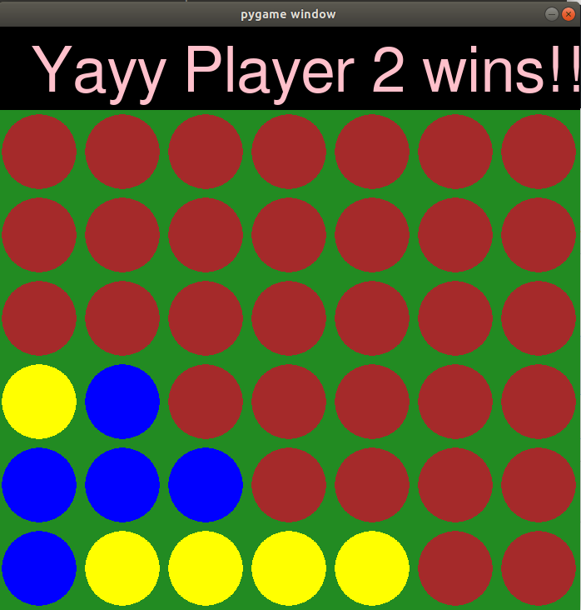
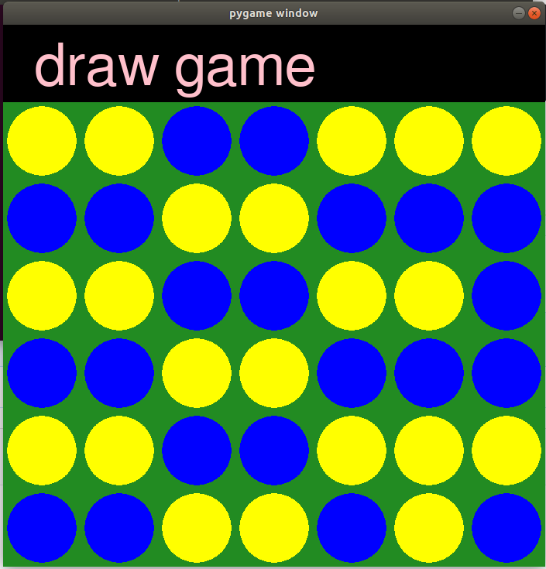
Task 1.3 Connect 4 GUI
Screen Shots:
Player Two wining : Game Draw:

Slide 24
Thank You

